Slide 1
no alpha
=
+
=
+

Slide 2
maybe alignment?

Slide 3
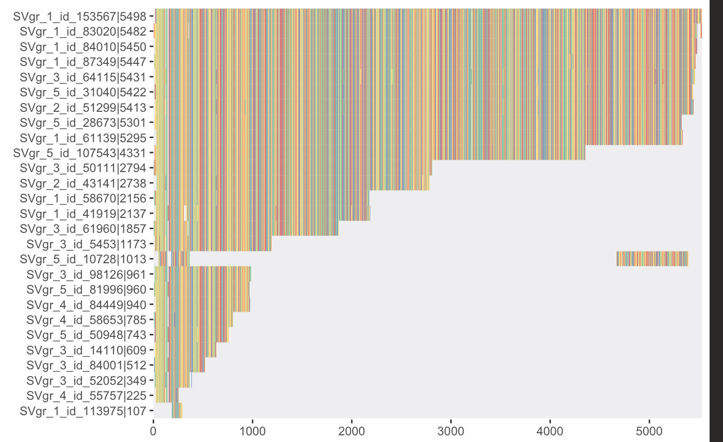

Slide 4
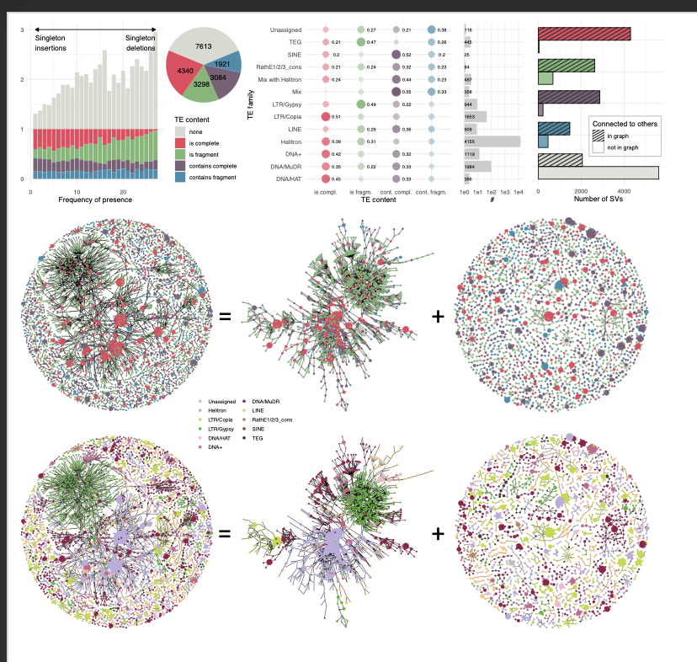







Slide 5
2
3
1
3
2
1
3
2
1
4
5
4
5
4
5

Slide 6
Real TEs story: not all annotated TEs are TEs. Many small sequences are fragments or repeats, which even BLASt doesn’t want to catch.
If they are in the graph of nestedness – they are relatively long.

